Slide 1


Low-Power Sub-Threshold Design of Secure Physical Unclonable Functions
¹Lang Lin, ²Dan Holcomb, ¹Dilip Kumar Krishnappa, ¹Prasad Shabadi, and ¹Wayne Burleson
    ¹ Department of Electrical and Computer Engineering
    University of Massachusetts, Amherst, USA
    ² Department of Electrical Engineering and Computer Sciences
    University of California, Berkeley, USA

Slide 2
Outline
Introduction
PUF circuits design in sub-threshold
Design evaluation
Conclusion and future work

Slide 3
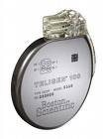



Introduction
Physical unclonable function (PUF)
  Unique challenge-response pairs (CRPs)
  Process variations: difficult to model, control and replicate
  Secure key storage and random number generation
PUF Implementations
  First PUF: random speckle pattern of optical materials
  Ring oscillator, delay arbiter or metastability-based circuits
  Power-up states of SRAM and other memory chips
Affordable security for low-power applications

Slide 4
Design Goals
Power: RFID Gen2, <1.28MHz, 1-5uW, <2000GEs
Uniqueness: the independence of PUF responses to the same challenge. ~ 50%
Reliability: the consistency of PUF CRPs with respect to dynamic environment variations. ~100%
Security: the resistance against various attacks
  PUF can inherently resist invasive attacks and reverse engineering, which will change the physical properties
  But still attackable by non-invasive modeling attacks and physical implementation attacks

Slide 5
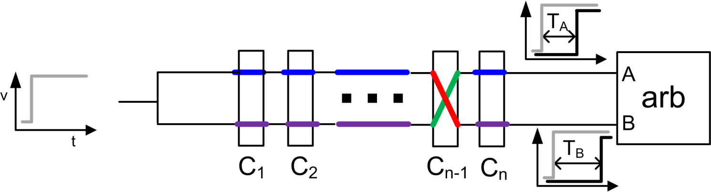
Arbiter PUF
Conventional arbiter PUF (Devadas et al., MIT)
  Two pulses race on two delay paths
  N bits challenges on n stages: swap or not?
  An arbiter to decide the faster pulse (edge triggered)
High uniqueness: random gate/interconnect delays on two paths due to process variations
High reliability: “common-mode” environment variation

Slide 6
Why Sub-threshold PUF?
  Pros
  1. Reduced power consumption to enable security in low-power applications
  2. Increased process variation sensitivity that leads to higher uniqueness and randomness
  Cons
  Circuits need to be modified for extreme voltage scaling
  Potentially lower reliability and reduced noise margin

Slide 7
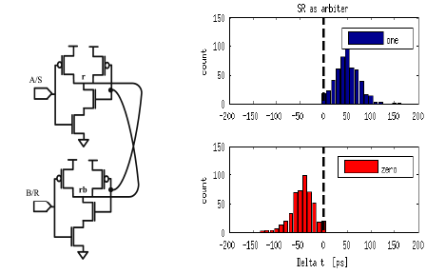
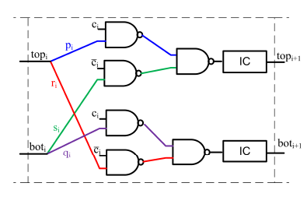
Sub-th PUF Design
Design methodology
  45nm CMOS PTM mode, process variations based ITRS
  Interconnect model: post-layout parasitics extraction
Circuit optimizations
  Stage circuit: gate input ordering to mitigate delay un-matching problems at each stage
  Arbiter circuit: SR-latches with symmetric competitions

Slide 8
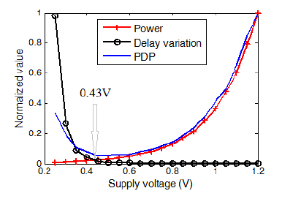
Optimizing PDP
How to choose the supply voltage?
  Low voltage reduces power
  Low voltage increases stage delay
  Low voltage increases delay variations under process variations, which is good for PUF uniqueness

Slide 9
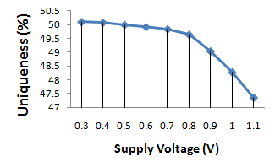
Evaluation: Uniqueness
Unbiased interconnects on PUF stage can reduce uniqueness
Methods
  Give 25 challenges to 40 16-stage PUF instances
  Calculate the Hamming distance (HD) of the response bits of each PUF pair
  Uniqueness=HD / 25
Results:
  sub-th: 50.08%
  super-th: 47.36%

Slide 10
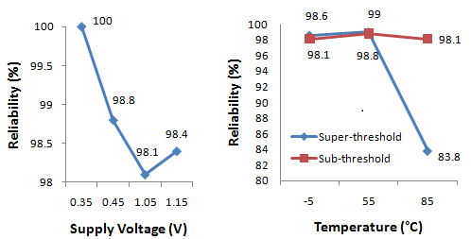
Evaluation: Reliability
Deals with bias (common-mode) but not noise
Supply voltage / temperature reliability
  Give ±0.05V Vdd bias on sub-th (0.4V) and super-th (1V)
  Vary the temperature @ -5°C, 55°C, 85°C

Slide 11
Evaluation: Security
Software modeling attacks
  Observe many CRPs of a PUF to model and predict its delay behavior
  Assumption: 256 CRPs are known to attackers
  Prediction accuracy close to 90% for both sub-threshold and super-threshold designs
Power side-channel analysis attacks
  Measure and analyze the transient power of PUF to extract the response bits
  Assumption: physical implementation of PUF consumes data-dependent power
  Sub-threshold PUF achieves 2X smaller correlation coefficient (simulated power traces and response bits)

Slide 12
Conclusive Results
A complete 64-stage PUF design
  Sub-threshold PUF (in 36µm*50µm die footprint):
    45nm CMOS technology, 418 GEs
    65% less energy/cycle than super-threshold design
    High uniqueness, no compromised reliability and security
 | Sub-threshold PUF | Super-threshold PUF
Power | 0.047µW @ 1MHz | 136.4µW @ 1GHz
Energy/Cycle | 0.047pJ | 0.136pJ
Future work
  Chip fabrication
  Post-silicon validations

Slide 13
Backup Slides

Slide 14
Our Recent Research
Leakage power as side-channel information:
“Leakage-Based Differential Power Analysis (LDPA) on Sub-90nm CMOS Cryptosystems,” by L. Lin and W. Burleson, In IEEE ISCAS 2008.
Process variation impacts on power analysis attacks:
“Analysis and Mitigation of Process Variation Impacts on Power-Attack Tolerance,” by L. Lin and W. Burleson, In ACM/IEEE DAC 2009.
The concept and FPGA implementation of Trojan side-channels:
“Trojan side-channels: lightweight hardware Trojans through side-channel engineering,” by L. Lin, M. Kasper, T. Guneysu, C. Paar and W. Burleson, In CHES 2009.
ASIC validation of Trojan side-channels:
“MOLES: malicious off-chip leakage enabled by side-channels,” by L. Lin, W. Burleson and C. Paar, In ACM/IEEE ICCAD 2009.
ID and true random number generators:
“Power-Up SRAM State as an Identifying Fingerprint and Source of True Random Numbers,” by D. Holcomb, Wayne P. Burleson, Kevin Fu, In IEEE Transaction on Computers 58(9): 1198-1210, 2009.

Slide 15
Verayo PUF Products
Vera X512H (older/basic) arbiter PUF system
  create finite dictionary of challenge response pairs
    use only this dictionary to authenticate the PUF
    Use each CRP once only
Vera M4H (new/improved) arbiter PUF system
  ISO 14443 - 13.56 Mhz
  Chip parameters can be read once only
  Known parameters later used off-chip to predict correct responses to new challenges
    This avoids finite dictionary of CRPs as in X512H
FPGA PUFs
  "uses look up tables, registers, and memory”
IP (for ASIC or FPGA)

Slide 16
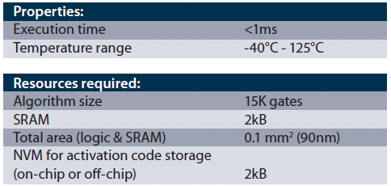
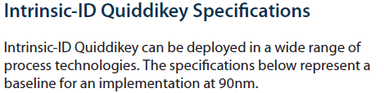
Intrinsic-ID Products
“Quiddikey” - SRAM PUF IP
  Deliverables:
    VHDL RTL code
    Synthesized gate-level netlist
  No custom silicon sold
  They advertise performing advanced aging tests – tech node unclear

